Slide 1
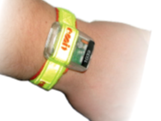
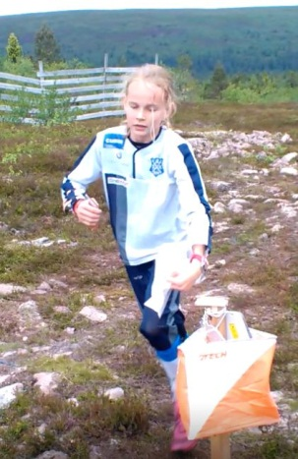
Information Touch-Free 06/05
emiTag
The emiTag should be strapped around the wrist as shown on the picture. High speed punching is performed by holding the emiTag 20-50 cm from the control for a short moment. The LED light in the emiTag will start flashing, and keeps flashing for 10 seconds after the punch.
NOTE! It is important to see this flashing, since this is the only feedback telling you that the punch is performed correctly!!!!!!!
TOUCH-FREE PRO The controls are of the type Touch-Free PRO.
Punching range is 75cm.
The range is reduced by punching in high speed.
Touch-Free PRO unit is placed inside the o-flag.
Code number is placed on top.
It is not necessary to touch the control unit. Touch Free means Touch Free! START •Touch-Free Start PRO.
•Starting unit to “zero” the emiTags at start. This is also a check that the emiTag are working.
Finish
At finish there are loops on the ground so you can pass the finish line at full speed. The readout is after the finish line.
Example of punching and check of correct punch at high speed

